Slide 1

Building Agentic AI using Cloud Native Infrastructure
Siri Varma Vegiraju
Senior Software Engineer

Slide 2

Siri Varma Vegiraju
Senior Software Engineer
Freelance Contributor
LinkedIn: /sirivarma
Email: siri.varma@outlook.com
Twitter: @sirivegiraju

Slide 3
Agenda
What is Dapr ?
Core Building Blocks
Dapr Agentic Infrastructure
Fundamental blocks to build Agents
Demos
Conclusion

Slide 4

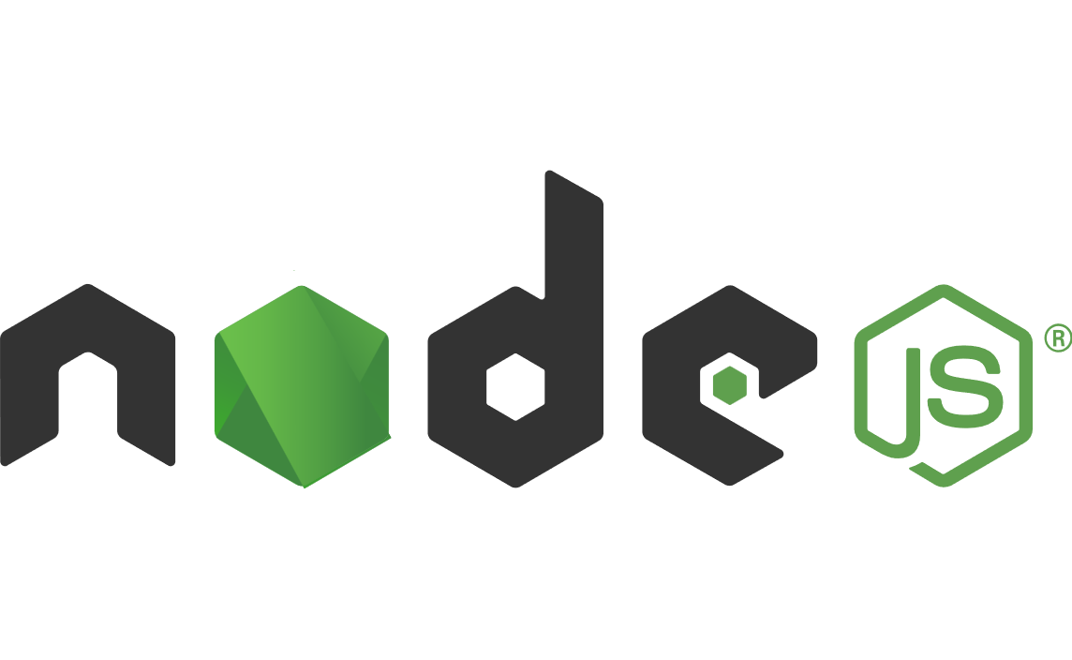

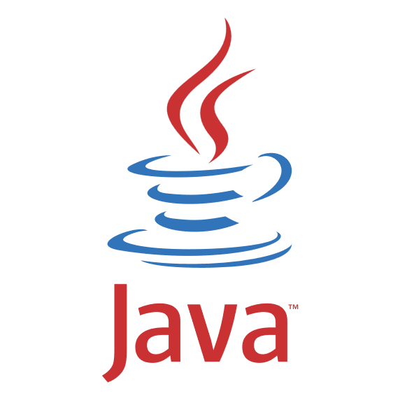
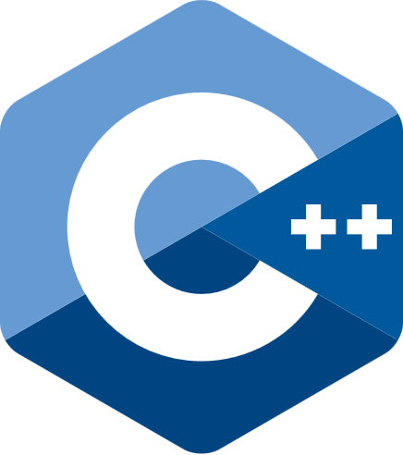

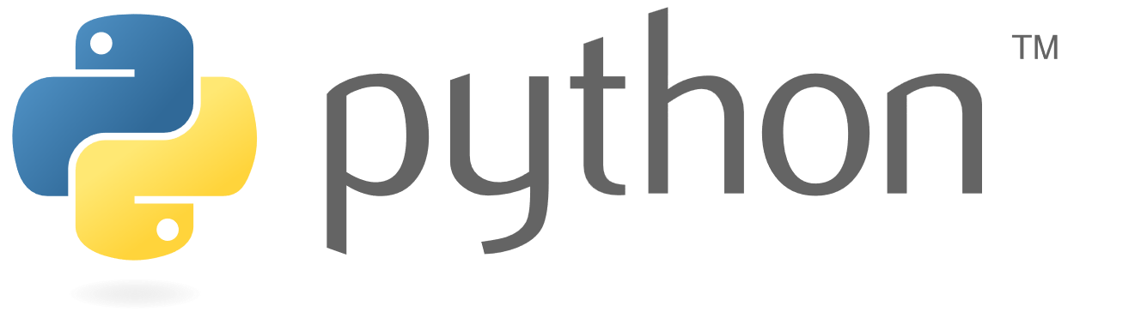


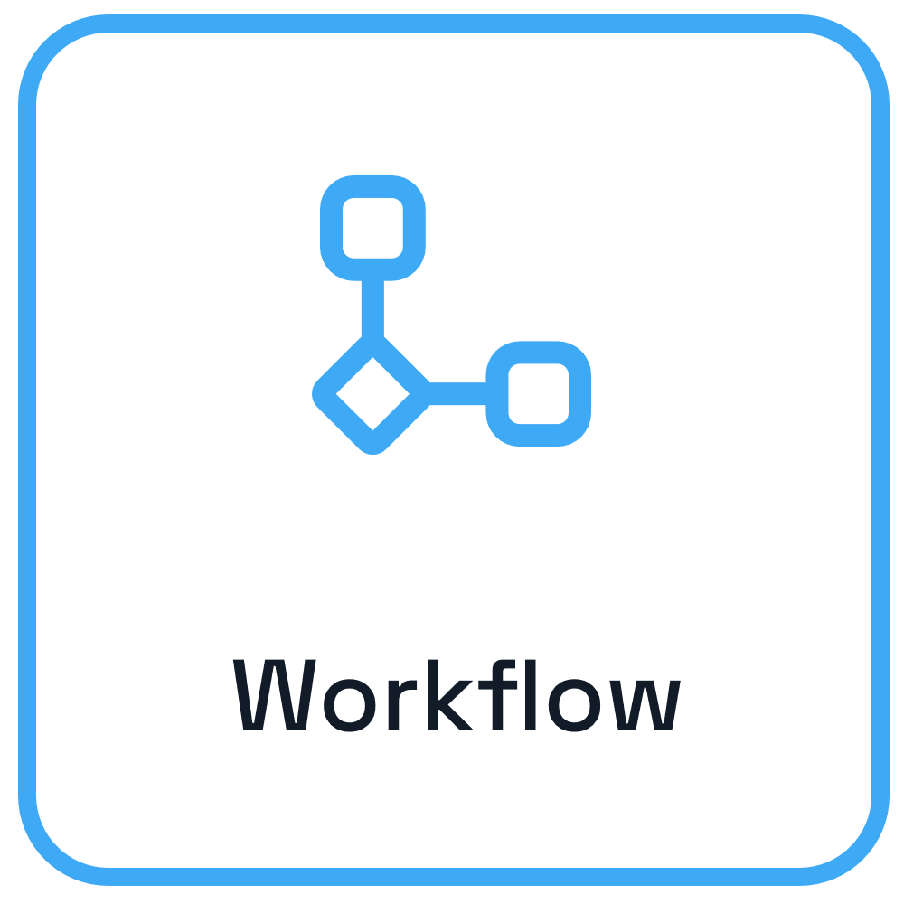

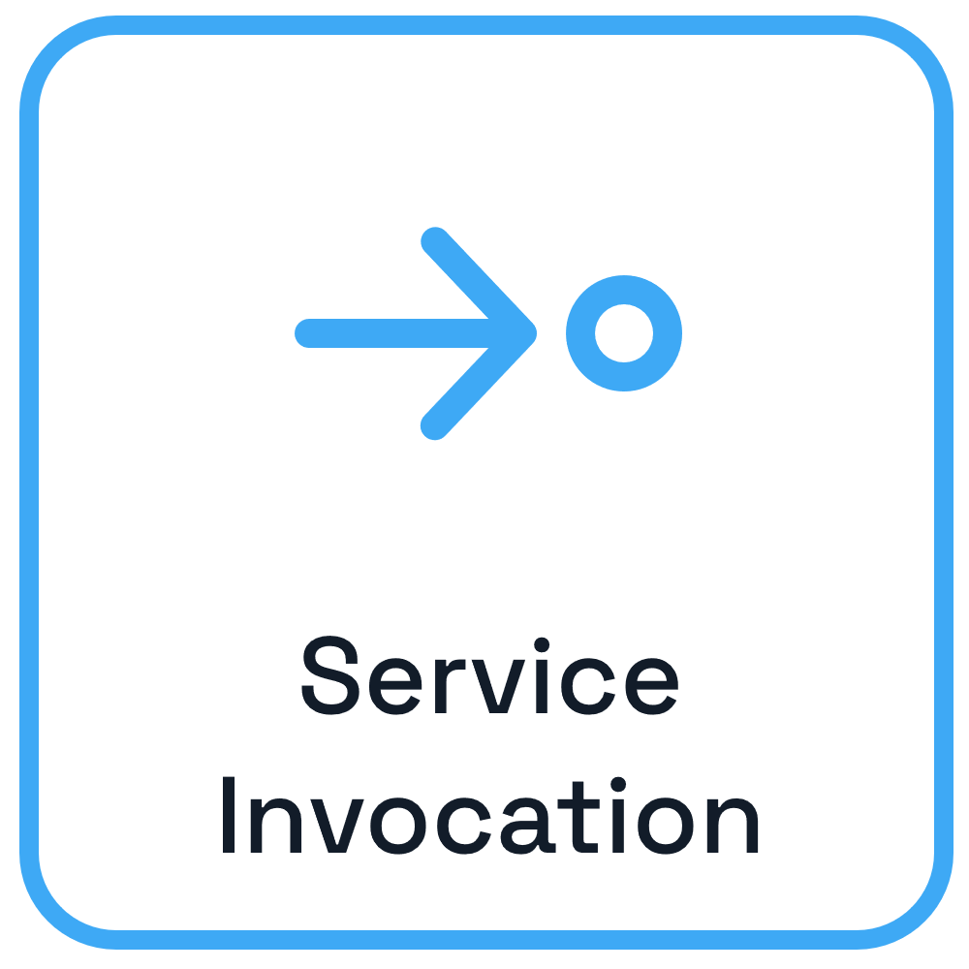
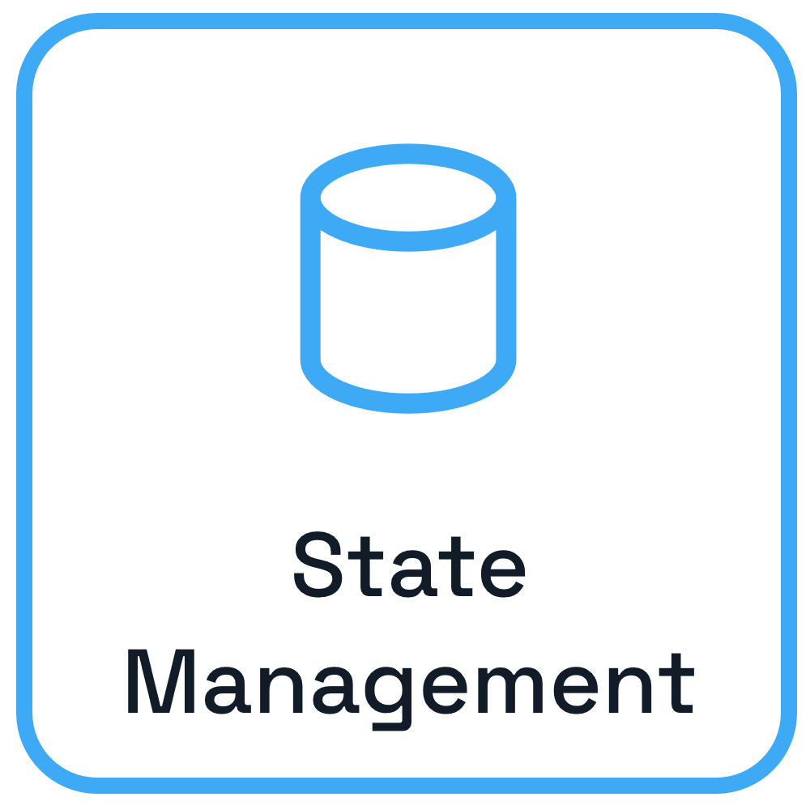
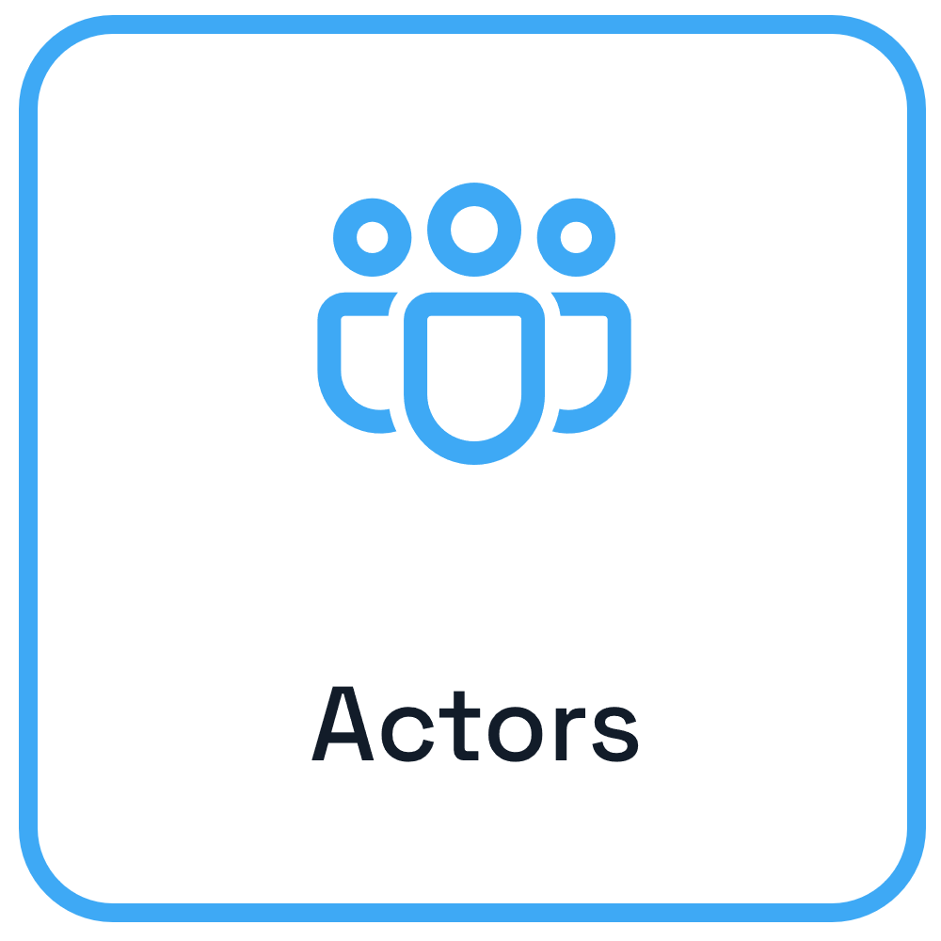

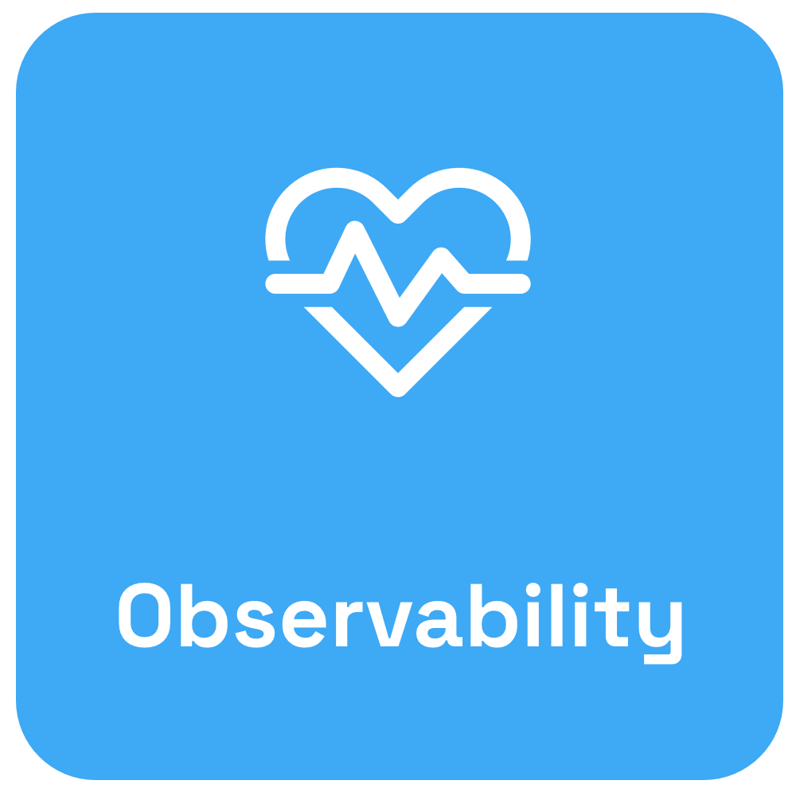

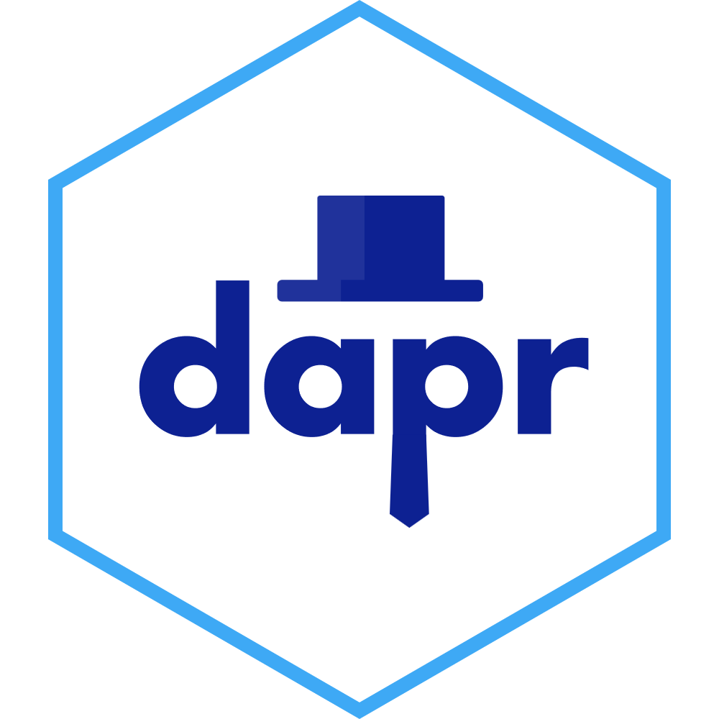
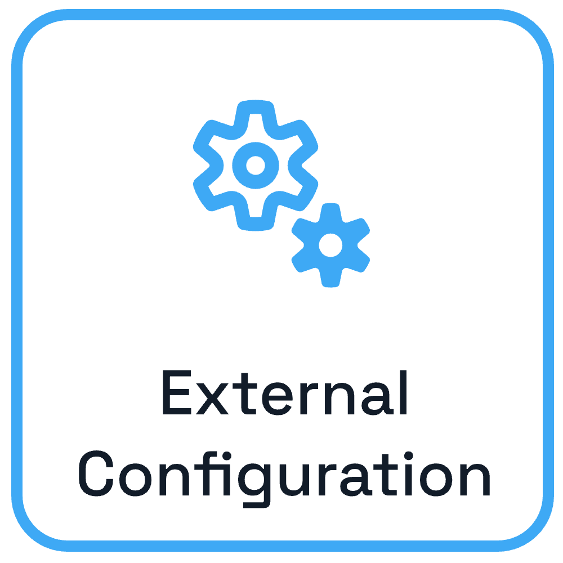

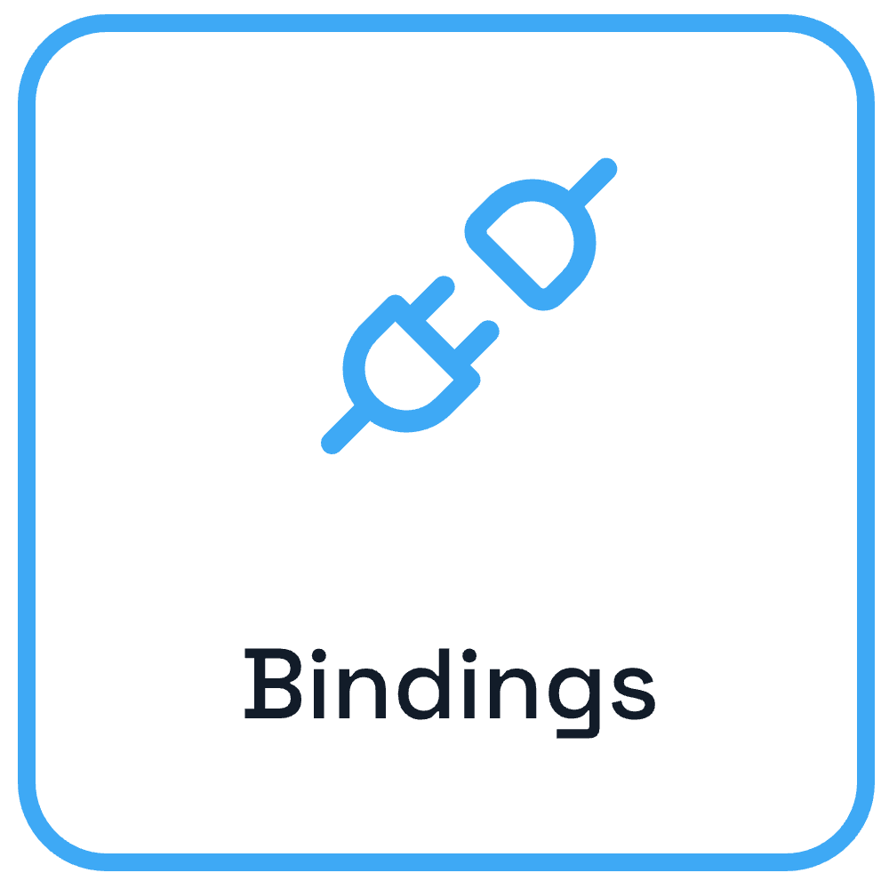

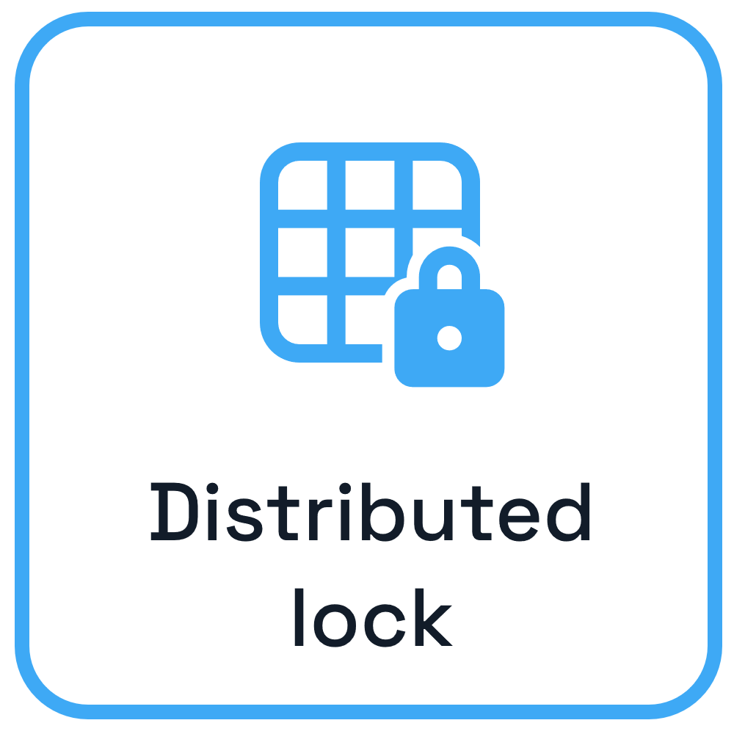

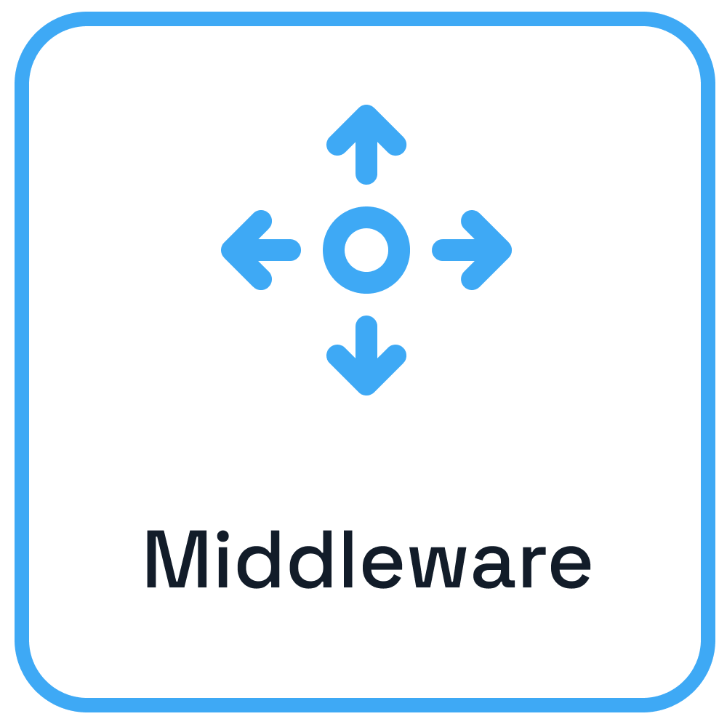









Dapr – Application developer platform
Use any language or runtime
App
HTTP/gRPC
Host on & integrate with any cloud or edge infrastructure
Databases
Message Brokers
Services

Slide 5
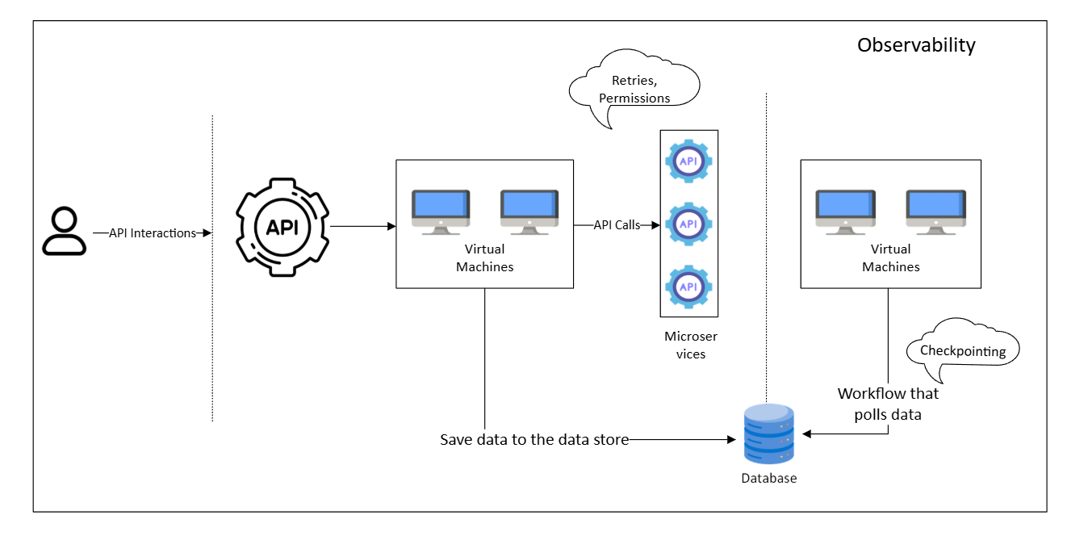

Slide 6
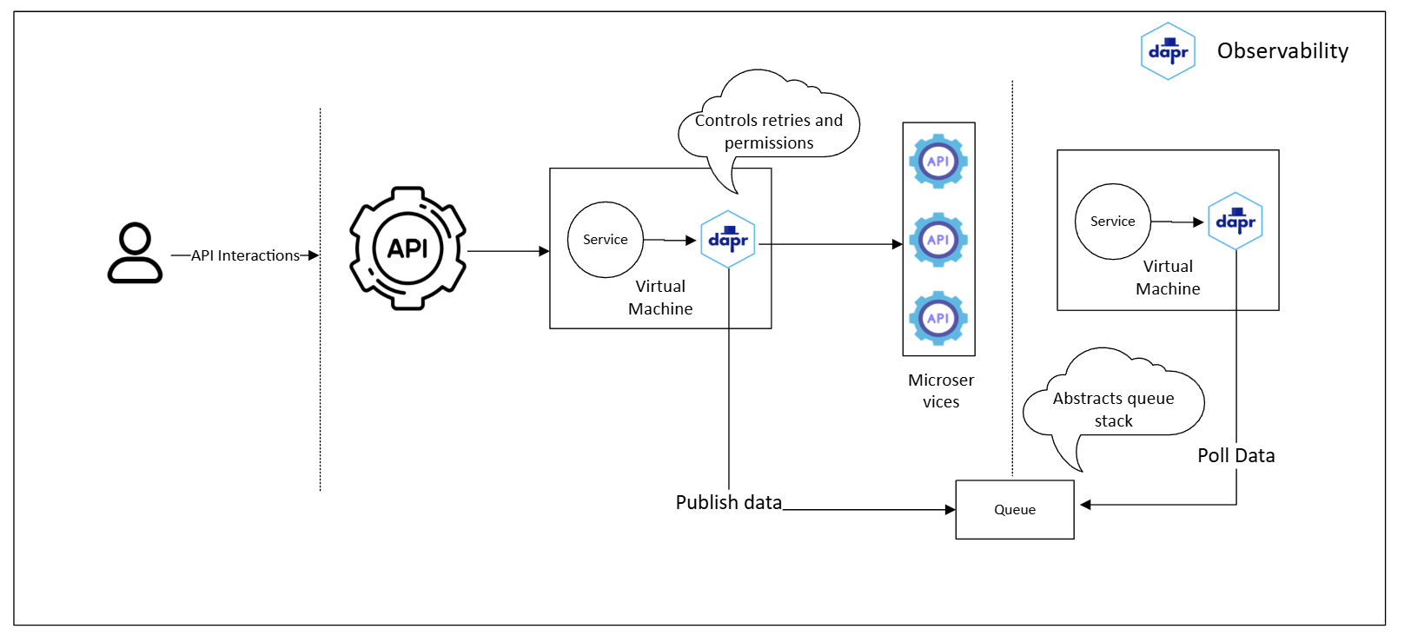
Architecture using Dapr

Slide 7

Dapr Agents

Slide 8
Agent Patterns
Tool Calling
Multi Agent

Slide 9
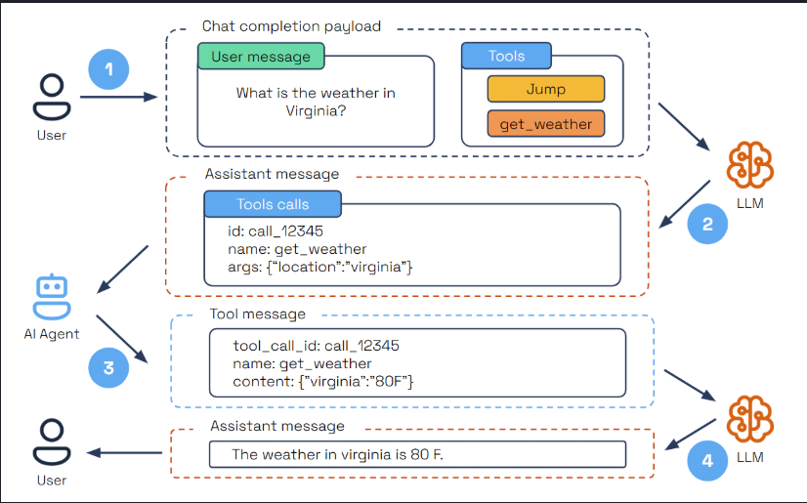
Tool Calling
Source: https://dapr.github.io/dapr-agents/concepts/agents/#tool-calling

Slide 10
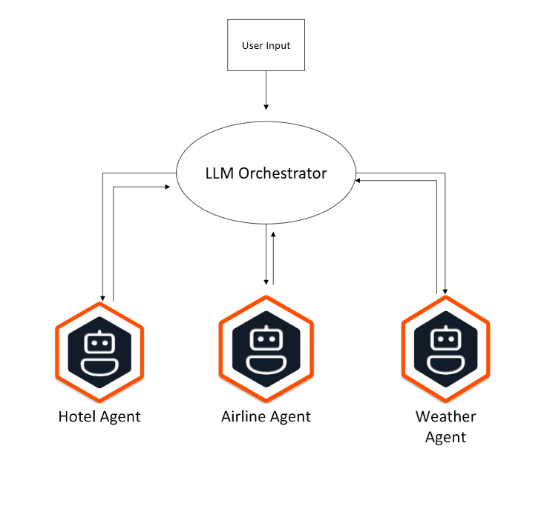
Multi Agent
LLM Orchestrator
Round Robin Orchestrator
Random Orchestrator

Slide 11
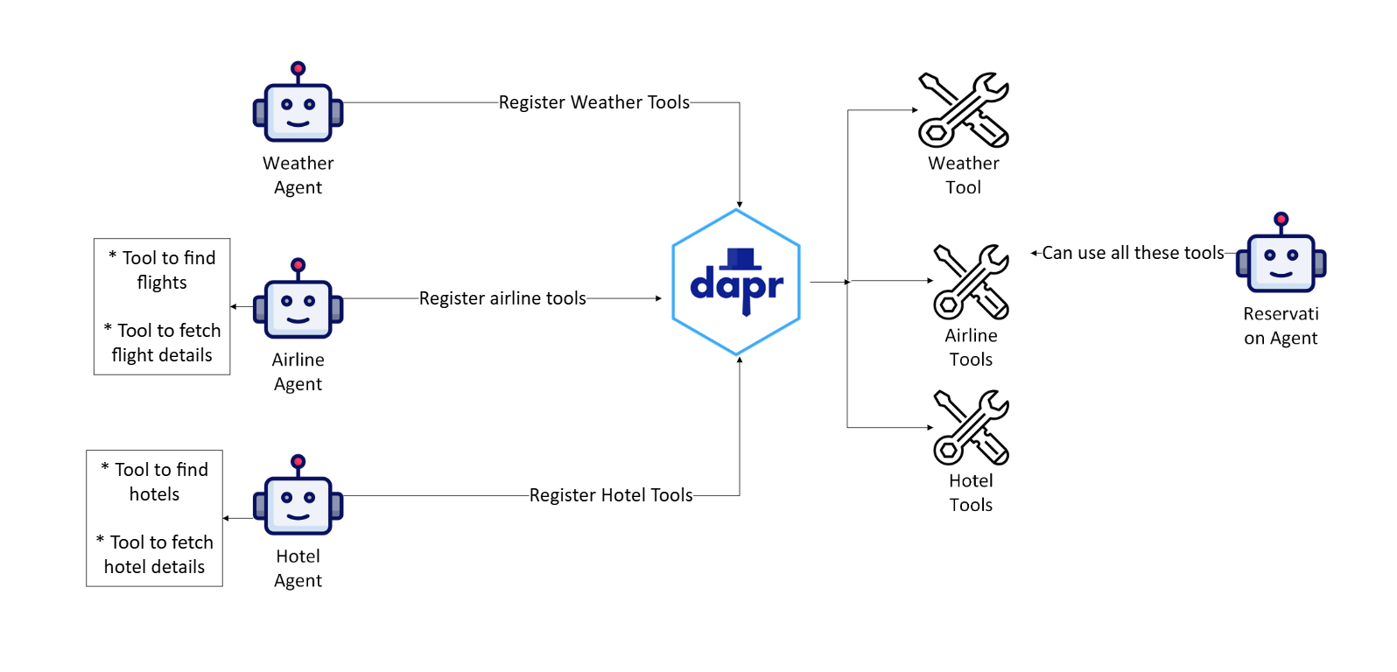
MCP

Slide 12
Summary
Scalable & Durable Workflows
Cost-Effective Agentic Architecture
Data-Centric AI Capabilities
Developer-First AI Toolkit
Secure, Reliable, and Open

Slide 13
Thank you

